Slide 1
Project Purpose
Support the marketing analyst team at Cyclistic to design a new marketing strategy to convert casual riders into annual members.
Annual Subscribers
Single Pass Purchaser

Slide 2
Statement of the Business Task
Design marketing strategies aimed at converting casual riders into annual members.
In order to do that, however, the marketing analyst team needs to better understand how annual members and casual riders differ, why casual riders would buy a membership, and how digital media could affect their marketing tactics.

Slide 3
Description of Data Sources
We will be using Cyclistic’s historical trip data to analyze and identify trends.
We are going to use latest data between January to December 2021.
The data has been made available by Motivate International Inc. so it is reliable and can be trusted for the analysis.
Data is located on a server (https://divvy-tripdata.s3.amazonaws.com/index.html).

Slide 4
Supporting Visualizations and Key Findings
These are some important graphs & inferences from the analysis.

Slide 5
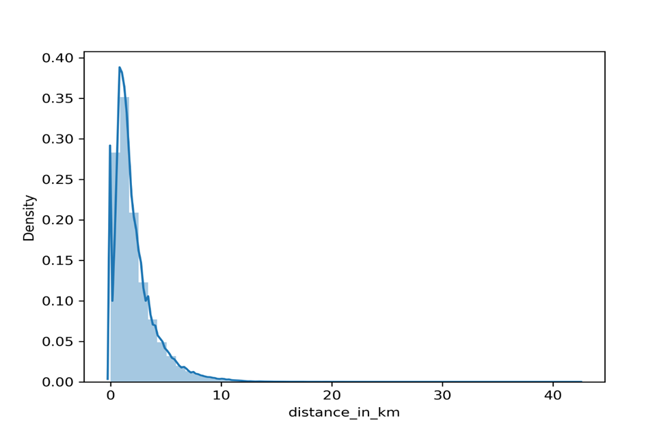
Analyzing trends of Average Distance Covered by Riders
Here We can see that the average distance covered is between 0 km to 10 km that means these bikes are primarily used for commuting inside the city only.

Slide 6
Analyzing trends of casual and member types on each Day of Week
If we consider Saturday and Sunday as weekends it seems like Member riders are using bikes mostly to commute to office & Casual Riders for leisure.

Slide 7
Here we can observe that on weekends both types of riders are covering more distances but overall distances but overall Casual rides are covering more distance.

Slide 8
Similar trend here also as Casual Members are traveling on average more than Member riders.

Slide 9
Analyzing trends of casual and member types on each Month of the Year
Here we can observe that both type of riders prefer around the end of Spring, Summer and starting of Autumn months but Casual Riders are mostly peaked during summer month whereas Member riders are little spread-out in other months also.

Slide 10
Analyzing trends of casual and member types in each Season

Slide 11
Here we can observe the same pattern in terms of riders in each month.

Slide 12
Analyzing trends of casual and member types on each Hour of Day
Here we can see that Member riders number peaks around office hours whereas casual riders are mostly using around Afternoon and Evening hours.

Slide 13
Analyzing trends of casual and member Riders Bike Preferences
Here we can observe that member rides prefer classic bike over electric bike maybe due to health measures whereas it’s opposite for Casual riders as they prefer electric bikes more compare to classic bike which may explain their higher average distance coverage.

Slide 14
Here we can observe that Member riders prefer using classic bikes in Summer and Spring months whereas Electric bikes in Autumn month and in Winters there is not much preference.

Slide 15
Here we can observe that Electric bikes are mostly preferred in each seasons.

Slide 16
Top Three Recommendations Based on My Analysis
Focus on the months when Casual Riders are much less than the annual members a the market is not saturated.
Focus on the bike preferences according to the season & take advantage of it.
Focus on the time spend and geo location tracking of the bike uses according to the start and end stations for marketing purpose.

